Slide 1


Eleftherios Nikolopoulos
2024-06-07

Slide 2

Outline
Executive Summary
Introduction
Methodology
Results
Conclusion
Appendix

Slide 3
Executive Summary
Methodology Summary
Collecting data via Space X REST API.
Collecting data from Wikipedia using the method of web scraping
Data wrangling in order to transform raw data into a more processed shape.
Analyzing data (Exploratory Data Analysis) by using both SQL and Pandas, Matplotlib for visualization
Using Folium and Plotly in order to create Interactive Visual Analytics and Dashboard so that users can find visual patterns faster and more effectively.
The employment of Predictive Analysis in order to build a machine learning pipeline and predict if the first stage of the Falcon 9 lands successfully.

Slide 4
Executive Summary
Summary of Results
Exploratory Data Analysis by using SQL.
The total number of successful and failure mission outcomes are 99 and 1 respectively.
Exploratory Data Analysis by using Pandas and Matplotlib
Orbits ES-L1, GEO, HEO & SSO have the highest success rates at 100%, with SO orbit having the lowest success rate at ~50%. Orbit SO has 0% success rate.
Predictive Analysis
All the methods (Logistic Regression, SVM, Decision Tree, KNN) perform the same accuracy of 0.833333 on the test Data

Slide 5
Introduction
SpaceX advertises Falcon 9 rocket launches on its website with a cost of 62 million dollars. Other providers cost upwards of 165 million dollars each.
The competitive advantage of SpaceX is the fact that it can reuse the first stage.
A machine learning model will predict whether the first stage will successfully land, in order to determine what attributes are correlated with successful Falcon 9 rocket landings and therefore determine the cost of a launch.

Slide 6

Section 1

Slide 7
Methodology
Executive Summary
Data collection methodology:
Data collection with Space X REST calls
Data collection with Web Scraping
Perform data wrangling
Cleaning the data by removing or correcting inaccuracies, inconsistencies and duplicates
Perform exploratory data analysis (EDA) using visualization and SQL
Perform interactive visual analytics using Folium and Plotly Dash

Slide 8
Methodology
Perform predictive analysis using classification models
We split data into training and testing data
Training data is divided into validation data
The models are trained and hyper parameters are selected
We display the best parameters and the accuracy on the validation data
We calculate the accuracy on the test data

Slide 9
Data Collection
Space X REST API
We use the SpaceX REST API with the endpoint “api.spacexdata.com/v4/launches/past”
We perform a get request using the requests library to obtain the past launch data from the API.
We view the results by calling the .json() method and the response is in the form of a JSON.
We convert the form of a JSON to a dataframe by using the json_normalize function.
Web Scraping
We use the Python Beautiful Soup package to web scrape some HTML tables from Wiki pages.
We parse the data from HTML tables and convert them into a Pandas data frame for further visualization and analysis.

Slide 10
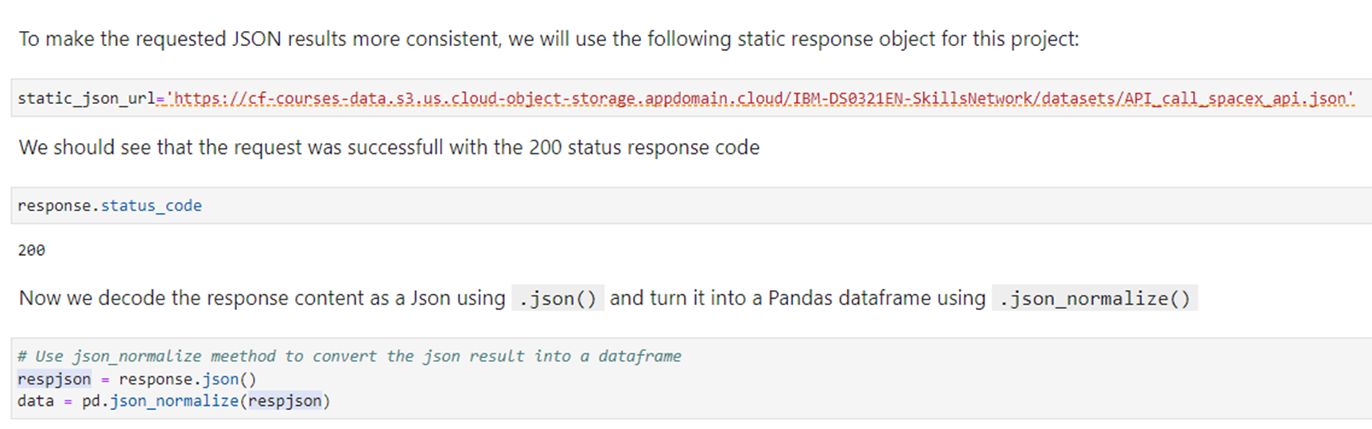
Data Collection – SpaceX API
Rocket launch data are collected by using SpaceX REST API and making a get request to the API. The response content with data is parsed and decoded as a form of JSON using .json() and turn it into a Pandas dataframe using json_normalize()
Add the GitHub URL of the completed SpaceX API calls notebook https://github.com/LeftyN/Nikolopoulos-Lefteris-/blob/5edbb72cda5348ba69096371461a758c46c83206/1.SpaceX%20Falcon9%20first%20stage%20landing%20prediction.ipynb
Place your flowchart of SpaceX API calls here

Slide 11
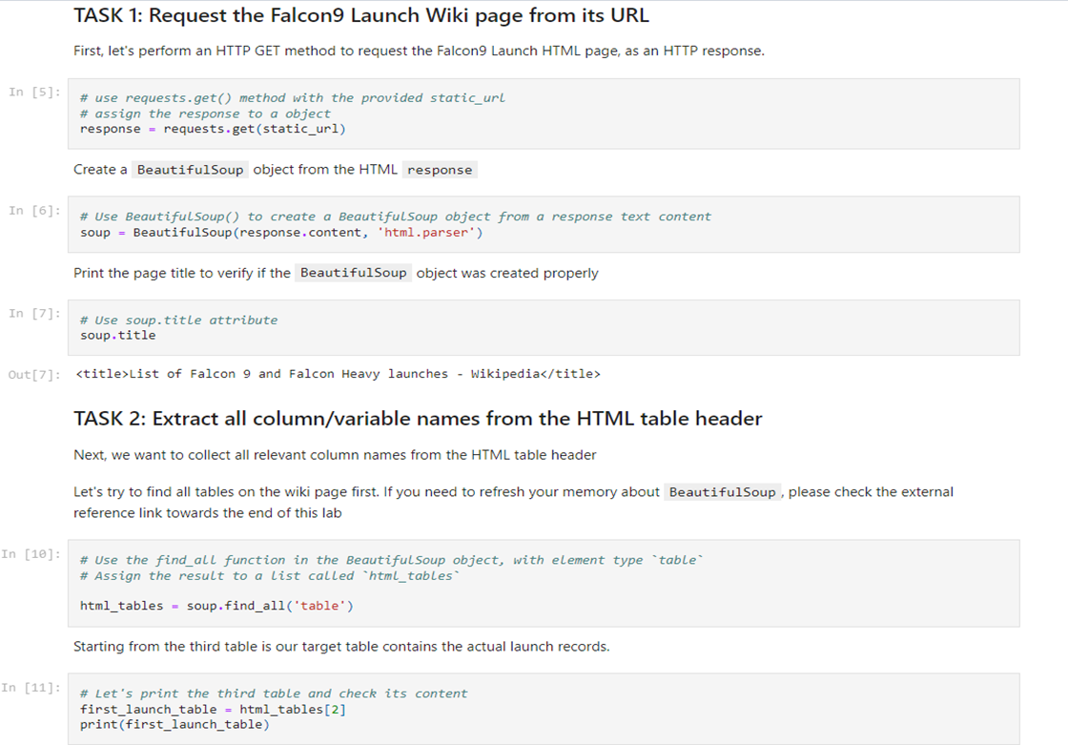
Data Collection – Scraping
In order to collect Falcon 9 past launch data from Wiki, beautiful soup package is used for parsing HTML files and finally extracting HTML data which are converted into pandas Data Frame structure.
Add the GitHub URL of the completed web scraping notebook: https://github.com/LeftyN/Nikolopoulos-Lefteris-/blob/5edbb72cda5348ba69096371461a758c46c83206/2.Web%20scraping%20Falcon%209%20and%20Falcon%20Heavy%20Launches%20Records%20from%20Wikipedia%20.ipynb
Place your flowchart of web scraping here

Slide 12
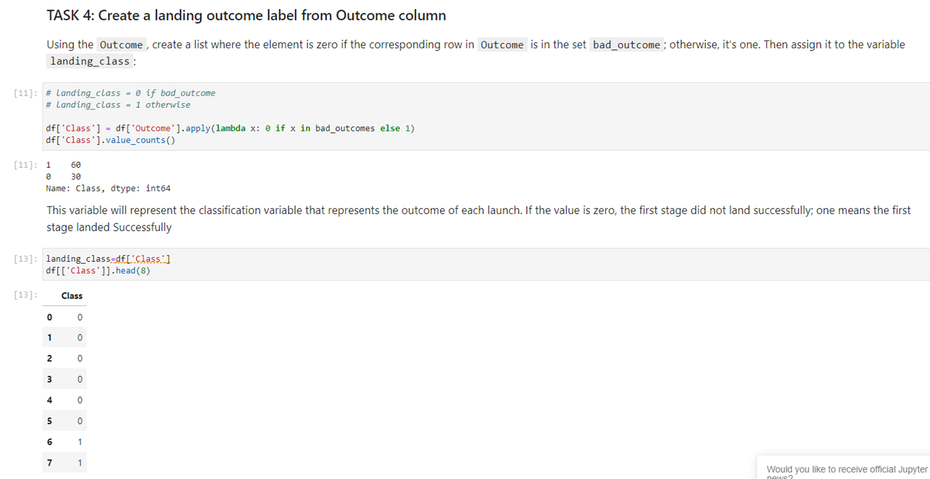
Data Wrangling
The data of Booster Version column are filtered to keep falcon 9 launches.
The missing values of Landing Pad and Pay load Mass columns are dealt with.
Some Exploratory Data Analysis (EDA) is performed in order to determine the label for training supervised models. The labels are converted into training labels with 1 means the booster successfully landed 0 means it was unsuccessful.
Add the GitHub URL of your completed data wrangling related notebooks: https://github.com/LeftyN/Nikolopoulos-Lefteris-/blob/5edbb72cda5348ba69096371461a758c46c83206/3.%20Data%20Wrangling.ipynb
Place your flowchart of web scraping here

Slide 13
EDA with Data Visualization
Scatter plot is used to visualize the relationship between variables such as:
flight number and launch site
Payload and launch site
flight number and orbit type
Payload and orbit type
Bar chart is used to visualize the relationship between success rate of each orbit type
Line plot is used to visualize the launch success yearly trend
Add the GitHub URL of your completed EDA with data visualization notebook: https://github.com/LeftyN/Nikolopoulos-Lefteris-/blob/5edbb72cda5348ba69096371461a758c46c83206/5.%20EDA%20with%20Visualization%20.ipynb

Slide 14
EDA with SQL
SQL queries are performed in order to answer the following questions of the research:
The names of the unique launch sites in the space mission
5 records where launch sites begin with the string “CCA”
The total payload mass carried by boosters launched by NASA
The average payload mass carried by booster version F9 v1.1
The date when the first successful landing outcome in ground pad was achieved
The names of the boosters which have success in drone ship and have payload mass greater than 4000 but less than 6000
The total number of successful and failure mission outcomes
The names of the booster versions which have carried the maximum payload mass
The month names, failure landing outcomes in drone ship ,booster versions, launch site for the months in year 2015
The count of successful landing outcomes between the date 04-06-2010 and 20-03-2017
Add the GitHub URL of your completed EDA with SQL notebook: https://github.com/LeftyN/Nikolopoulos-Lefteris-/blob/5edbb72cda5348ba69096371461a758c46c83206/4.%20EDA%20with%20SQL.ipynb

Slide 15
Build an Interactive Map with Folium
An interactive folium map show all the launch sites using marker cluster object to display a large number of markers on a map like color-labeled markers to identify which launch sites have relatively high success rates.
Specifically, we create markers for all launch records, if a launch was successful (class=1), then a green marker is used and if a launch was failed, a red marker (class=0) is used
Additionally, an interactive folium map uses lines to explore and analyze the proximities of launch sites such as highways, coastline and cities.
Building an interactive map aims to discover some preliminary correlations between the launch site and success rates by performing more interactive visual analytics using Folium.
Add the GitHub URL of your completed interactive map with Folium map: https://github.com/LeftyN/Nikolopoulos-Lefteris-/blob/5edbb72cda5348ba69096371461a758c46c83206/6.%20Interactive%20Visual%20Analytics%20with%20Folium.ipynb

Slide 16
Build a Dashboard with Plotly Dash
In order to build the Dash application, several tasks are performed, such as:
The addition of a Launch Site Drop-down Input Component
The addition of a callback function to render success-pie-chart based on selected site dropdown
The addition of a Range Slider to Select Payload
The addition of a callback function to render the success-payload-scatter-chart scatter plot
Add the GitHub URL of your completed Plotly Dash lab: https://github.com/LeftyN/Nikolopoulos-Lefteris-/blob/5edbb72cda5348ba69096371461a758c46c83206/7.%20An%20Interactive%20Dashboard%20with%20Ploty%20Dash.py

Slide 17
Predictive Analysis (Classification)
Exploratory Data Analysis is performed and Training Labels are determined in order to:
create a column for the class
Class values: 1 and 0 for successful and unsuccessful launch respectively
A NumPy array is created from the column Class in data, by applying the method to_numpy() then assign it to the variable Y
standardize the data
The data are standardized in X then reassign it to the variable X
split into training data and test data
The function train_test_split is used to split the data X and Y into training and test data by setting the parameter test_size to 0.2 and random_state to 2.
The training data is divided into validation data, a second set used for training data

Slide 18
Predictive Analysis (Classification)
We find the best Hyperparameter for SVM, Classification Trees and Logistic Regression and KNN by creating the following objects:
a logistic regression object and then a GridSearchCV object (logreg_cv) with cv = 10.
a support vector machine object and then a GridSearchCV object (svm_cv) with cv =10
a decision tree classifier object and then a GridSearchCV object (tree_cv) with cv = 10
a k nearest neighbors object and then a GridSearchCV object (knn_cv) with cv = 10.
We calculate the accuracy on the test data, using the method “score” for each method (logistic regression, classification tree, SVM, KNN), in order to find the method that performs best
Add the GitHub URL of your completed predictive analysis lab: https://github.com/LeftyN/Nikolopoulos-Lefteris-/blob/5edbb72cda5348ba69096371461a758c46c83206/8.%20Space%20X%20Machine%20Learning%20Prediction.ipynb

Slide 19
.
Results
Exploratory data analysis results
Interactive analytics demo in screenshots
Predictive analysis results

Slide 20

Section 2

Slide 21
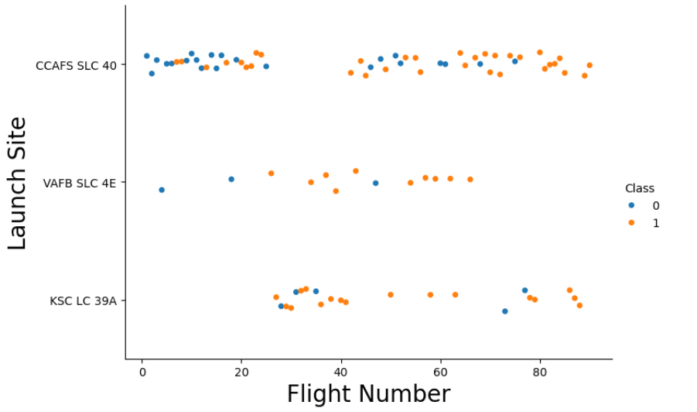
Flight Number vs. Launch Site
The success (class 1) or the failure (class 0) of a launch outcome in correlation with the launch sites and the flight number

Slide 22
Flight Number vs. Launch Site
It can be noticed that the launch success rate (class 1) of all launch sites gets higher as the flight number of rockets increases. The launch site with the higher success rate is KSC LC 39A

Slide 23
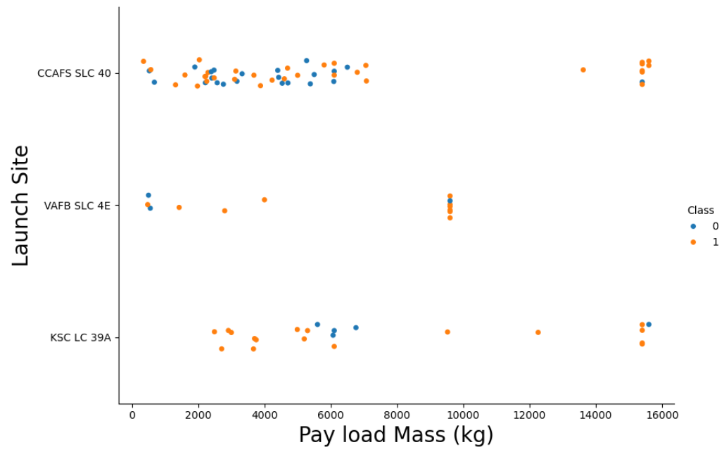
Payload vs. Launch Site
The success (class 1) or the failure (class 0) of a launch outcome in correlation with the launch sites and the payload mass

Slide 24
Payload vs. Launch Site
It can be noticed that rockets, which have been launched from KSC LC 39A launch site, perform the highest success rate at 100%, provided the pay load mass is equal or less than 5,000 kg.
In general, payload mass seems that is not a determining factor for the launch outcome in correlation with the launch sites.

Slide 25
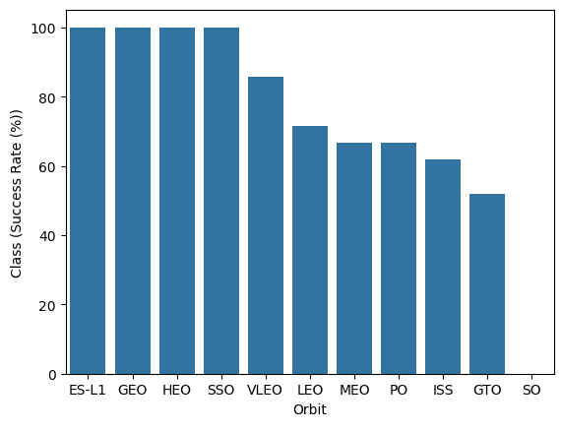
Success Rate vs. Orbit Type
The success rate of launch outcome in correlation with the type of orbits that rockets have carried out.

Slide 26
Success Rate vs. Orbit Type
It can be noticed that rockets that have created certain type of orbits like ES-L1, GEO, HEO, SSO, the rate of successful launch outcome is 100%. To the contrary, rockets that have created SO orbit, the success rate is 0%.

Slide 27
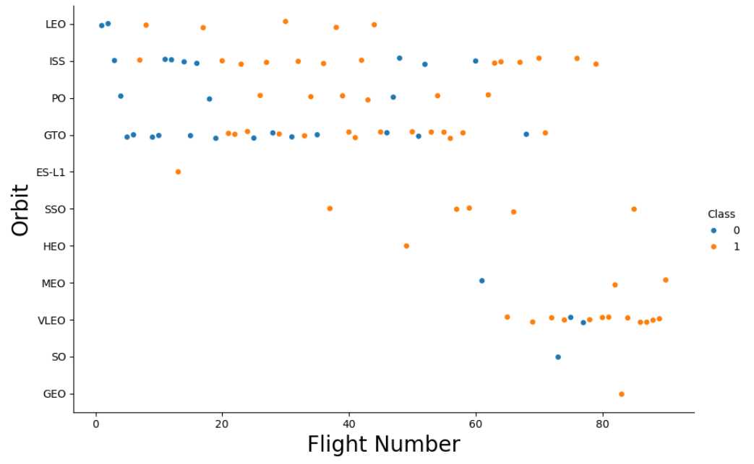
Flight Number vs. Orbit Type
The success (class 1) or the failure (class 0) of a launch outcome in correlation with the orbit type that a rocket have made and the flight number

Slide 28
Flight Number vs. Orbit Type
It can be noticed that the launch success rate (class=1) increases for all types of orbit that rockets have created as the flight number increases, and especially, that happens for rockets with VLEO and ISS orbits.

Slide 29
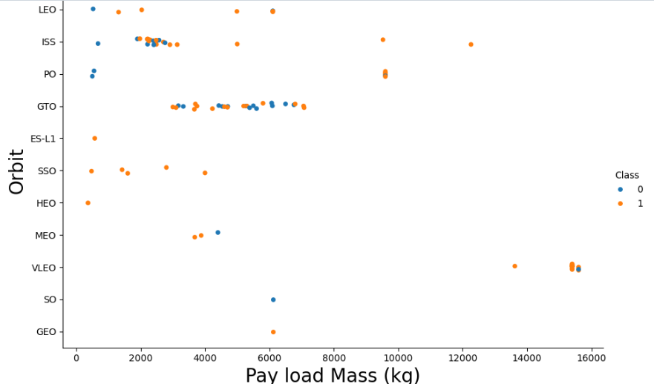
Payload vs. Orbit Type
The success (class 1) or the failure (class 0) of a launch outcome in correlation with the orbit type that a rocket have made and the pay load mass.

Slide 30
Payload vs. Orbit Type
It can be noticed that the launch success rate (class=1) is 100% when rockets have created SSO orbit and the pay load mass is equal or less than 4,000 kg.
However, pay load mass seems to be a non-determining factor for the launch outcome in correlation with the type of orbit.

Slide 31
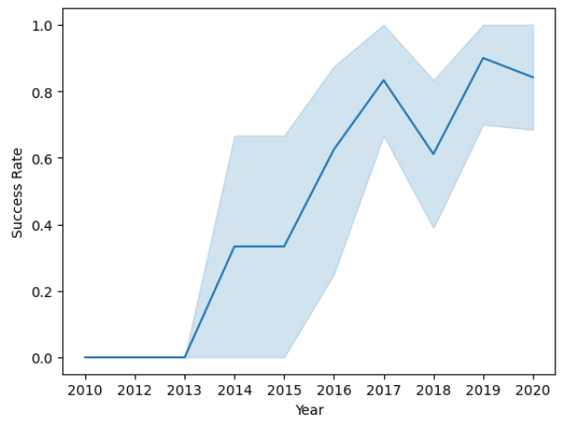
Launch Success Yearly Trend
The yearly average launch success rate of space X rockets

Slide 32
Launch Success Yearly Trend
According to the plot, the average launch success rate increases at 80% in 2017, over the period from 2013 to 2017. In 2018, the average success rate falls at 60%. Lastly, the average success rate peaks at 90% in 2019.

Slide 33
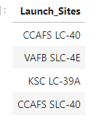
All Launch Site Names
The names of the unique launch sites in the space mission
There are four unique launch sites

Slide 34
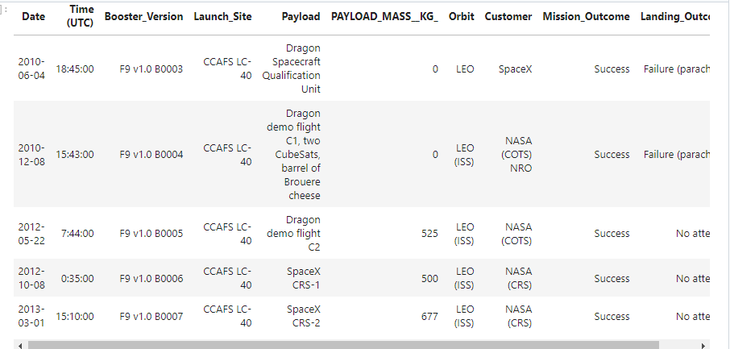
Launch Site Names Begin with 'CCA'
5 records where launch sites begin with the string “CCA”
The records include the launch site CCAFS LC-40

Slide 35
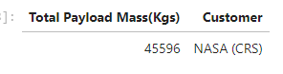
Total Payload Mass
The total payload mass carried by boosters and launched by NASA
The total payload mass used by NASA is 45,596 Kg

Slide 36
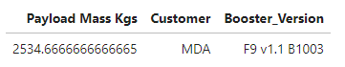
Average Payload Mass by F9 v1.1
The average payload mass carried by booster version F9 v1.1
The average payload mass carried by Falcon 9 booster is 2534.66 Kg

Slide 37
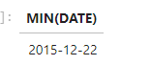
First Successful Ground Landing Date
The date when the first successful landing outcome in ground pad was achieved
The date when the first successful landing in ground pad took place is on 12 December 2015.

Slide 38
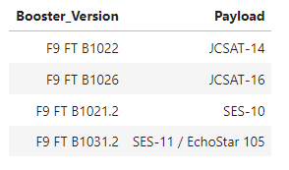
Successful Drone Ship Landing with Payload between 4000 and 6000
The names of the boosters which have success in drone ship and have payload mass greater than 4000 but less than 6000
There are four distinct booster names with successful landing in drone ship and payload mass greater than 4000 but less than 6000

Slide 39
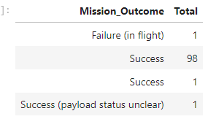
Total Number of Successful and Failure Mission Outcomes
The total number of successful and failure mission outcomes
The total number of successful and unsuccessful space X mission outcome is 100 and 1 respectively

Slide 40
Boosters Carried Maximum Payload
The names of the booster versions which have carried the maximum payload mass using sub query

Slide 41
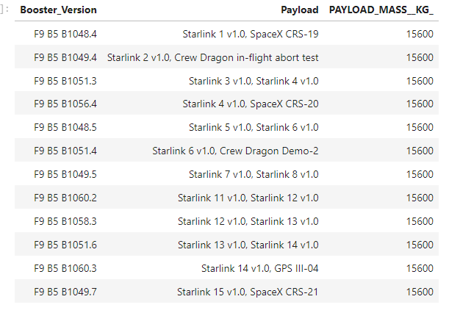
Boosters Carried Maximum Payload
There are twelve boosters have carried payload mass equals 15,600 kg which is equivalent to the maximum payload mass

Slide 42
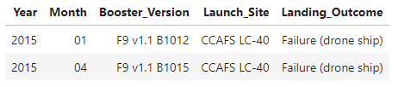
2015 Launch Records
Launch records that include month names, failure landing outcomes in drone ship ,booster versions, launch site for the months in year 2015. We use substr(Date, 6,2) as month to get the months and substr(Date,0,5)='2015' for year.
There are two 2015 launch records, in January and April when the Falcon 9 boosters failed to land in drone ship at CCAFS LC-40 launch site

Slide 43
Rank Landing Outcomes Between 2010-06-04 and 2017-03-20
The count of landing outcomes between the date 04-06-2010 and 20-03-2017

Slide 44
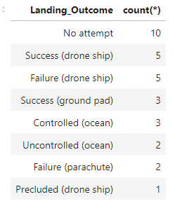
Rank Landing Outcomes Between 2010-06-04 and 2017-03-20
Mostly counted landing outcome is the fact that rockets could not enter into the landing process (No attempt). Other types of landing outcome that took place between 2010-06-04 and 2017-03-20 are successful landings both in drone ship (Success drone ship) and ground pad (Success ground pad), the failure landings in drone ship (Failure drone ship) or by using parachute (Failure parachute), controlled (Controlled ocean) and uncontrolled (Uncontrolled ocean) landings in ocean, and finally, precluded landings (Precluded drone ship) where rocket was not allowed to land in drone ship.

Slide 45

Section 3

Slide 46
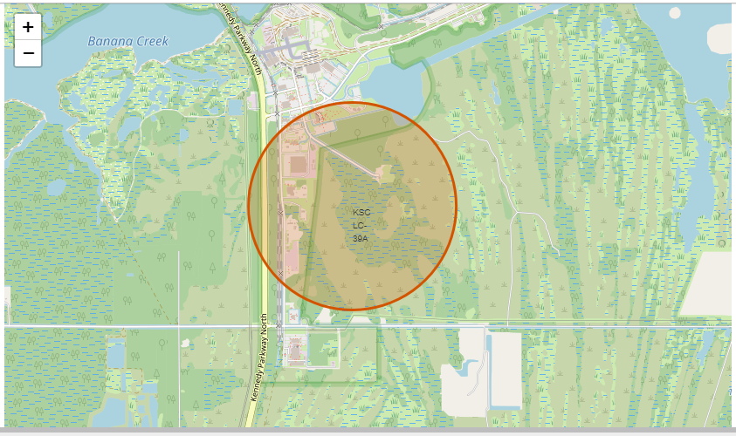
Marking launch sites with circle objects on the map
KSC LC 39A launch site in Florida.

Slide 47
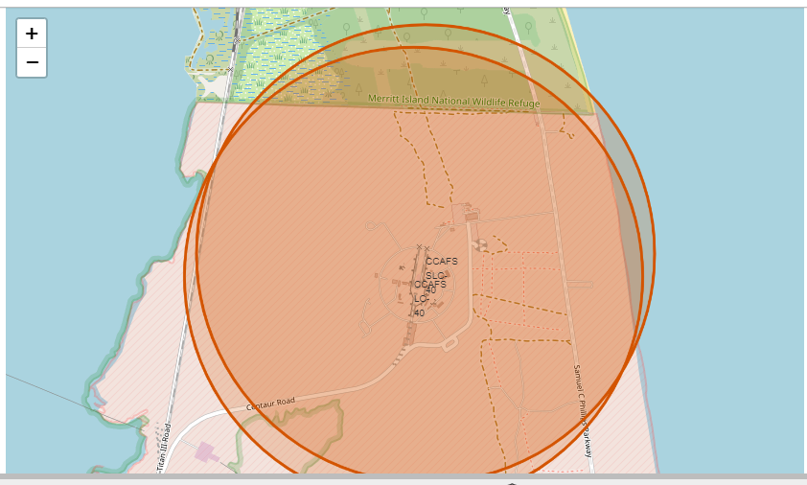
Marking launch sites with circle objects on the map
CCAFS SLC-40 and CCAFS LC-40 launch sites in Florida

Slide 48
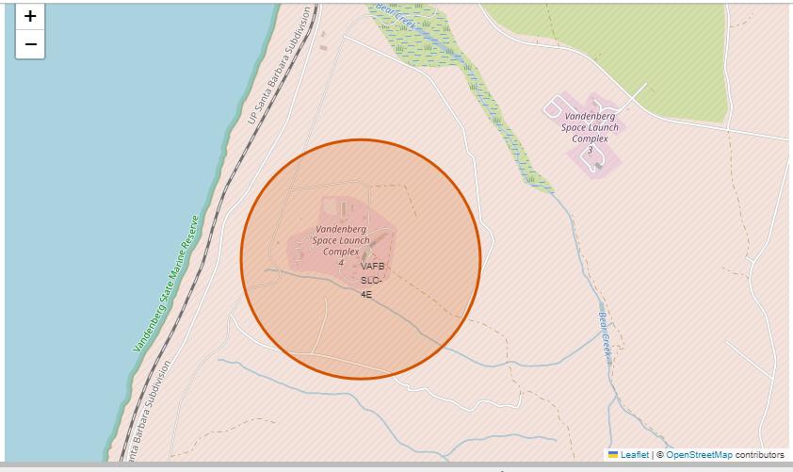
Marking launch sites with circle objects on the map
VAFB SLC-4E launch site in California

Slide 49
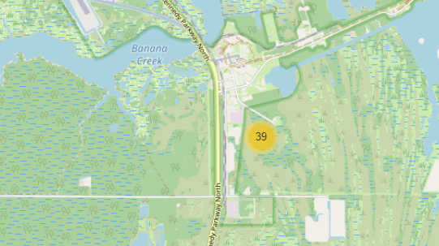
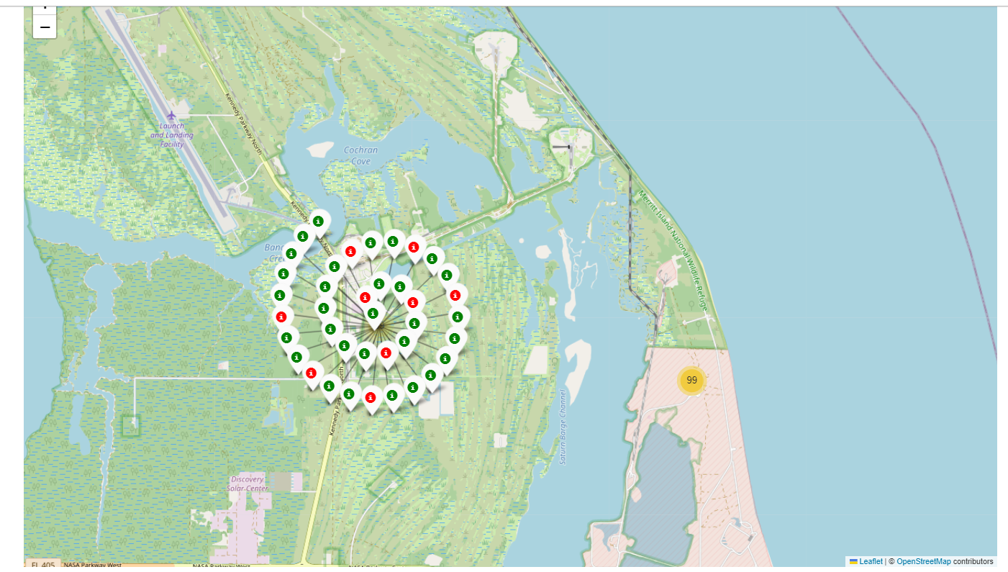
Using color markers for launch outcomes
KSC LC 39A launch site in Florida
There are 39 color markers. Green color markers (class=1) that significantly outnumber red color markers (class=0). That means successful rocket launches are much more than unsuccessful ones.

Slide 50
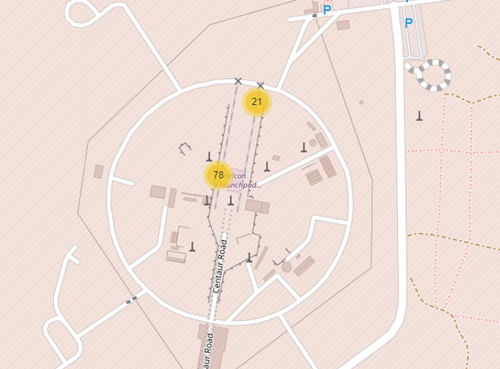
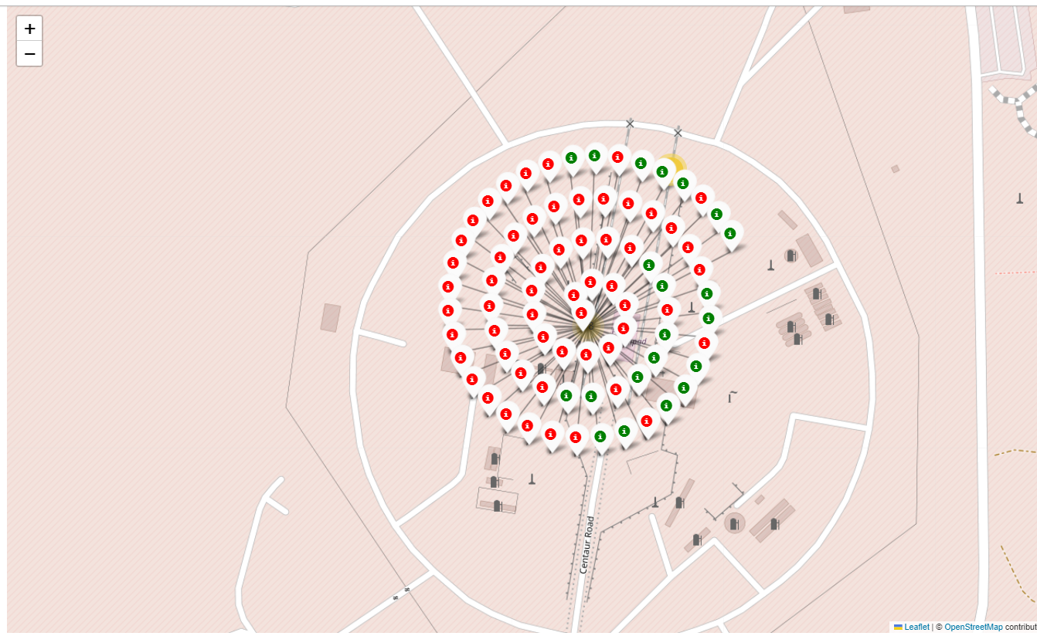
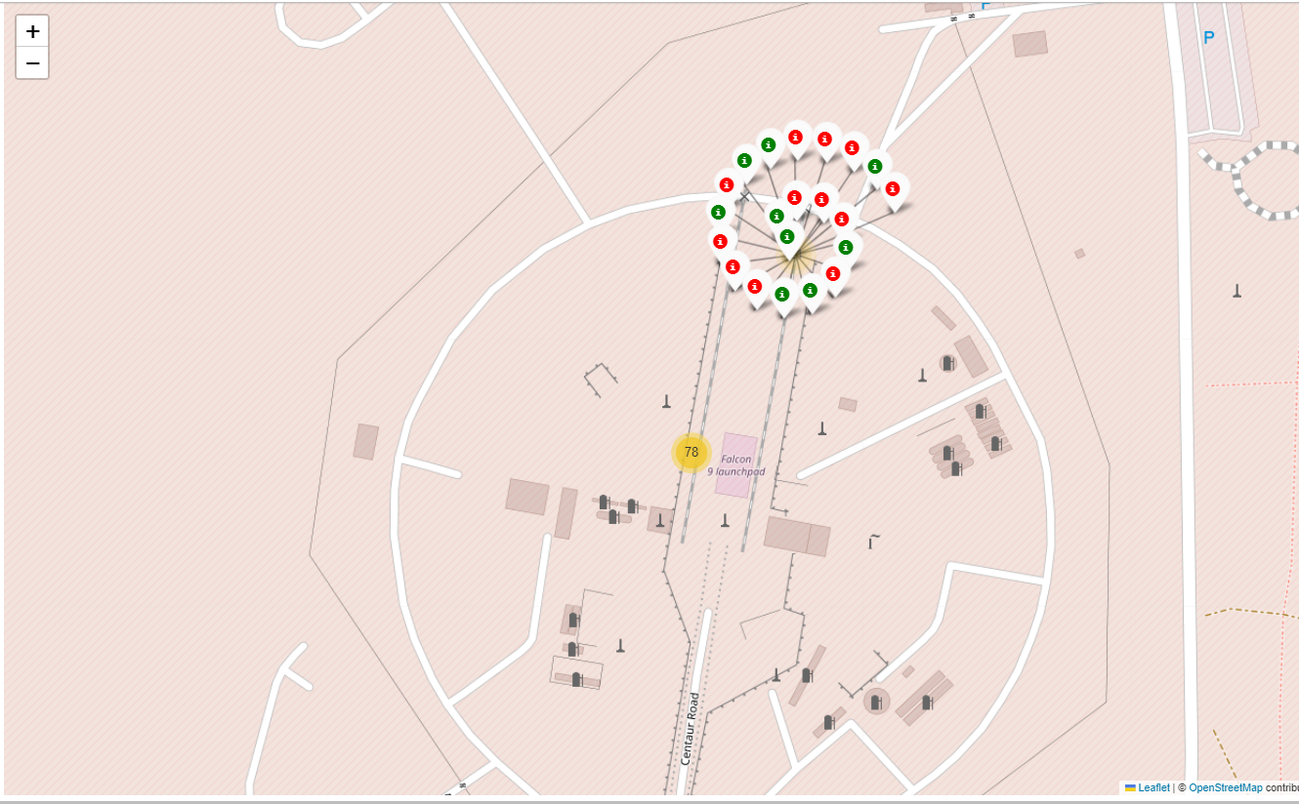
Using color markers for launch outcomes
There are 21 color markers on the CCAFS SLC-40 launch site and 78 color markers on the CCAFS LC-40 launch sites in Florida
The predominant color of markers is red (class=0) on both CCAFS LC-40 and CCAFS SLC-40 launch sites. That means unsuccessful rocket launches prevail over successful ones.

Slide 51
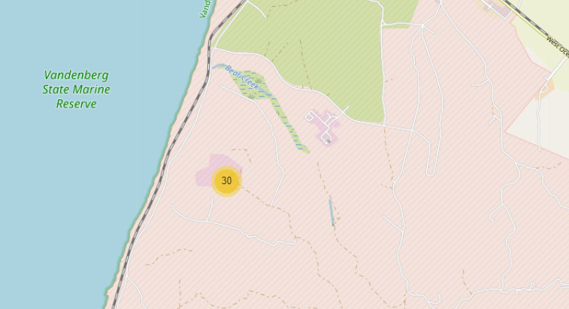
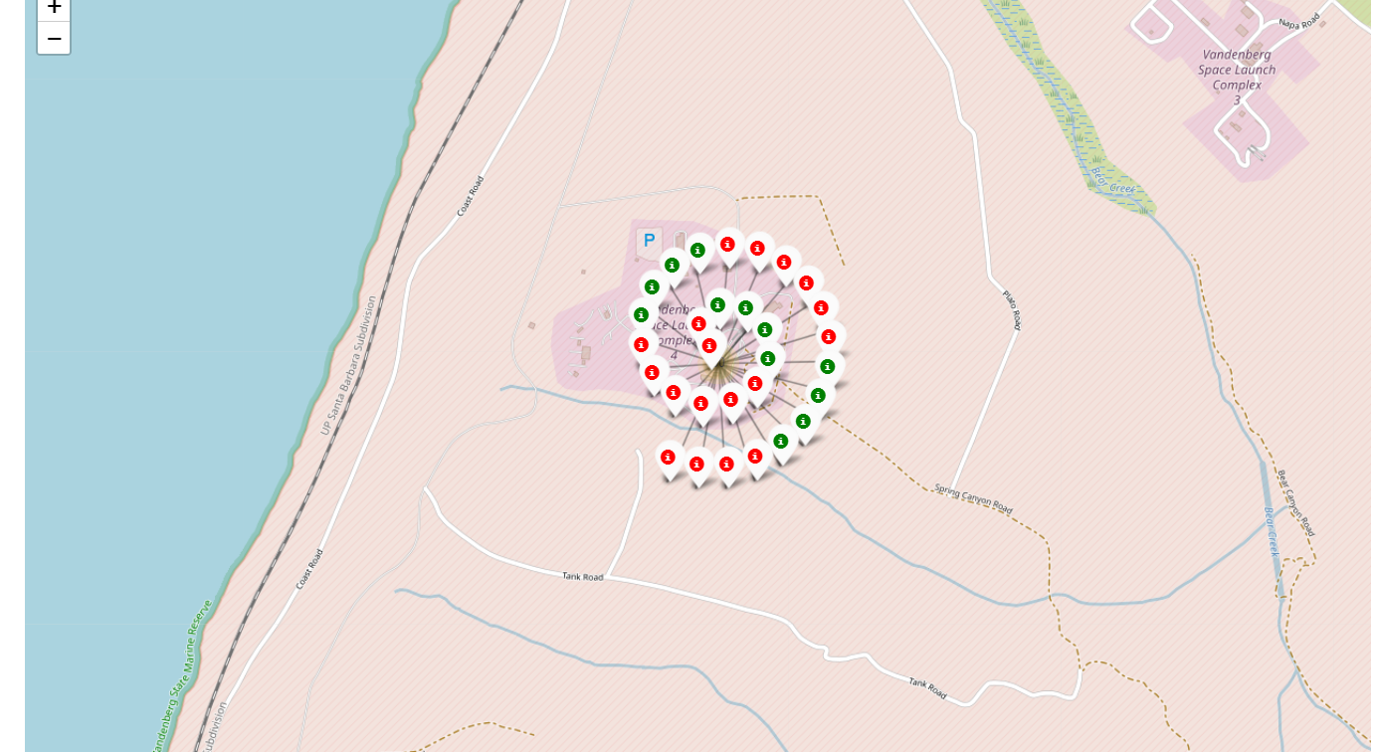
Using color markers for launch outcomes
VAFB SLC-4E launch site in California
There are 30 color markers. Green color markers (class=1) are slightly fewer than red color markers (class=0). It is not clear whether the launch site in California affects the launch outcome.

Slide 52
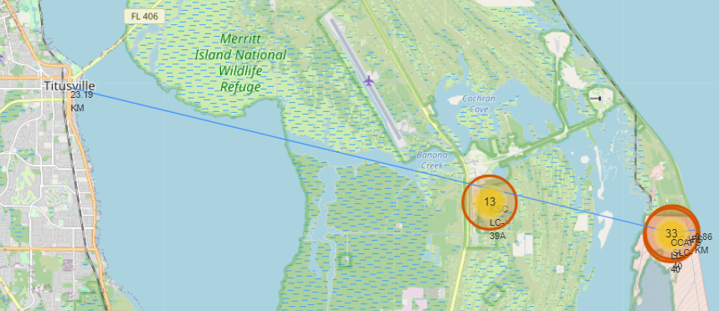
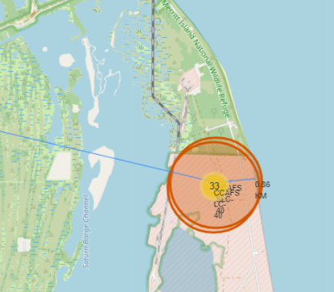
Calculating the distances between a launch site and its proximities
CCAFS SLC-40 launch site in Florida
The distance from Titusville city (latitude = 28.61208, longitude = -80.80764) is 23.19 Km
The distance from the coastline is 0.86 Km

Slide 53

Section 4

Slide 54
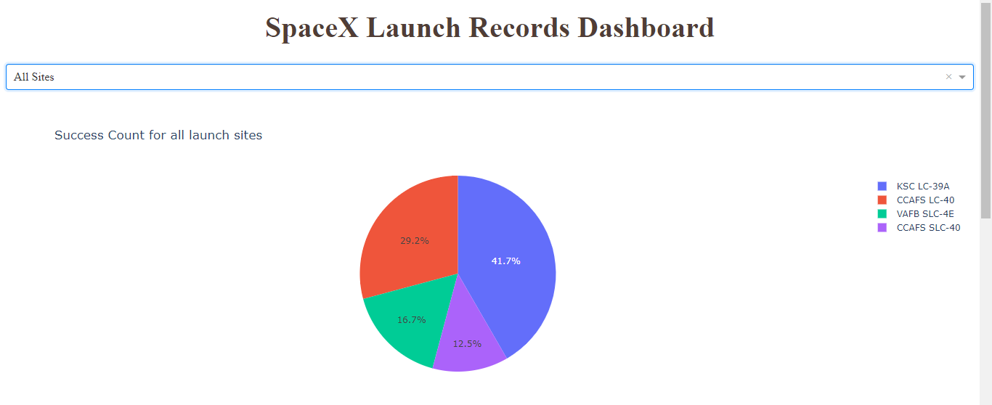
Launch success count for all launch sites
KSC LC-39A has the highest success rate at 41.7%
The success rate of CCAFS LC-40 launch site is at 29.2%
The success rate of VAFB SLC-4E launch site is at 16.7%
CCAFS SLC-40 launch site has the lowest success rate at 12.5%

Slide 55
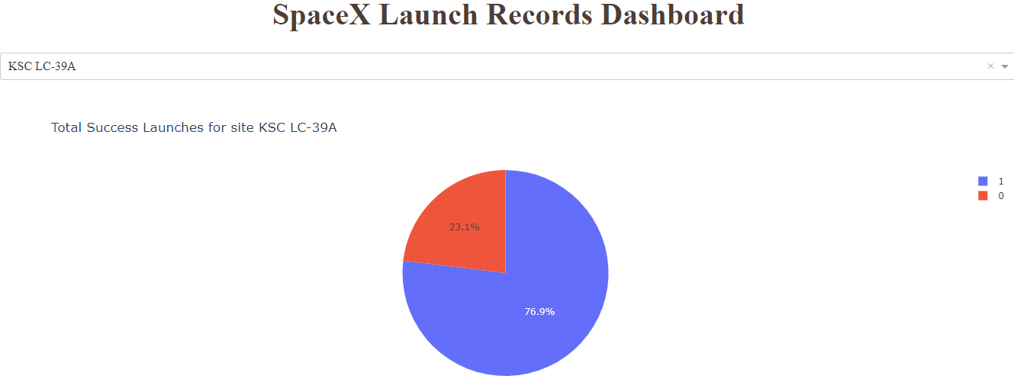
The launch success ratio of a launch site with the highest launch success rate
The launch success rate of the KSC LC-39A launch site is at 76.9%
The failed launch rate of the KSC LC-39A launch site is at 23.1%

Slide 56
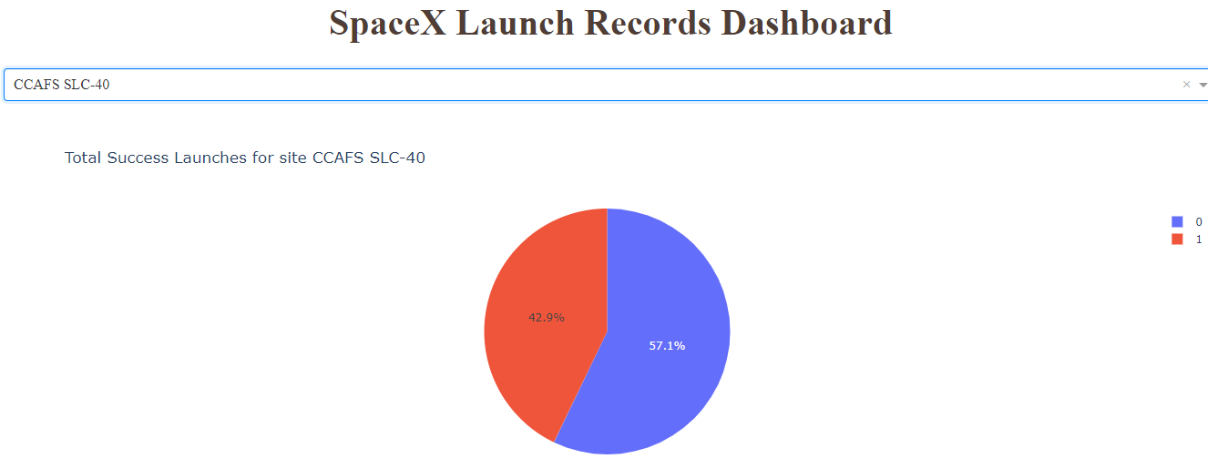
The launch success ratio of a launch site with the lowest launch success rate
The launch success rate of the CCAFS SLC-40 launch site is at 57.1%
The failed launch rate of the CCAFS SLC-40 launch site is at 42.9%

Slide 57
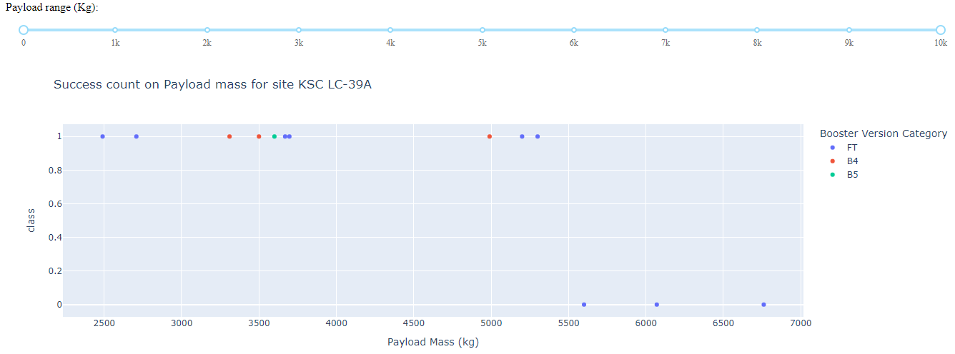
Launch outcome in correlation with payload mass for KSC LC-39A
The KSC LC-39A launch site has unsuccessful launches (class=0) using the FT booster version and the payload mass is higher than 5,500 Kg.

Slide 58
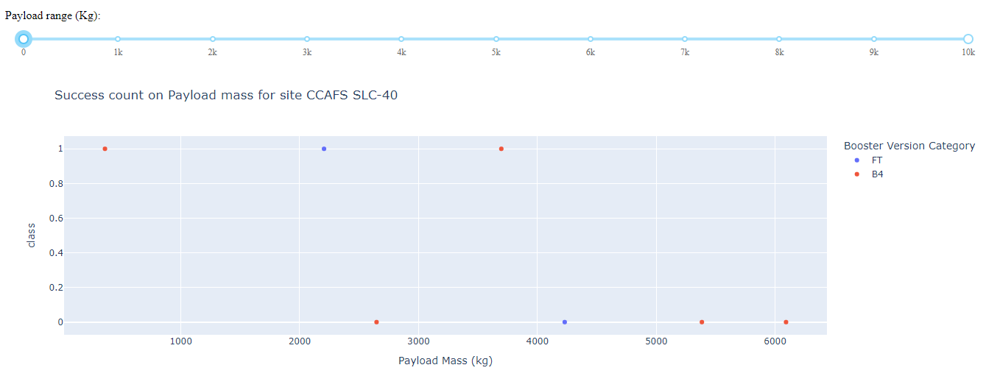
Launch outcome in correlation with payload mass for CCAFS SLC-40
The CCAFS SLC-40 launch site has mainly unsuccessful launches (class=0) using the B4 booster version and the payload mass is higher than 2,500 Kg.

Slide 59

Section 5

Slide 60
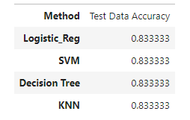
The accuracy rate for each method (Logistic regression, Decision Tree, SVM, KNN) is the same
Classification Accuracy

Slide 61
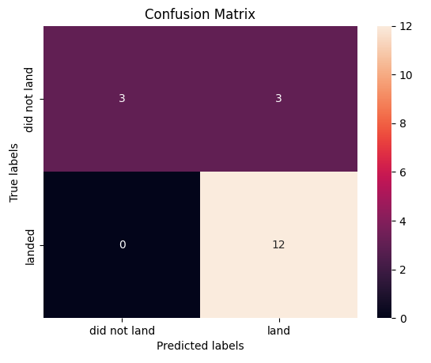
Confusion Matrix
According to the confusion matrix of all methods, we can deduce that all algorithms produce the same results
All the algorithms have failed to predict correctly for 3 times out of 18. Specifically, models have incorrectly predicted that rockets would land successfully but actually they did not manage to do so.
All the algorithms have correctly predicted for 15 times out of 18. Specifically, models have correctly predicted for 12 times that rockets would land successfully and for 3 times that rockets would not land.

Slide 62
Conclusions
VAFB SLC 4E, KSC LC 39A and CCAFS SLC 40 launch sites show that launch success rate is getting higher as flight number is increasing.
KSC LC 39A launch site shows the highest launch success rate, at 100%, as long as the payload mass is equal or less than 5,000 kg.
Rockets, which create types of orbit such as ES-L1, GEO, HEO & SSO, have the highest success rates at 100%.
Rockets that have made SSO orbit and the pay load mass is equal or less than 4,000 kg, the launch success rate is 100%.
KSC LC 39A launch site has the highest launch success rate at almost 42% and CCAFS SLC-40 has the lowest launch success rate at 12.5%.
The class is zero for the KSC LC-39A launch site when the FT booster version is used and the payload mass is higher than 5,500 Kg, while the class is zero for the CCAFS SLC-40 launch site when the B4 booster version is used and the payload mass is higher than 2,500 Kg.
All the classification methods (Logistic Regression, Decision Tree, SVM, KNN) has the same accuracy rate at 0.833.

Slide 63


